Slide 1
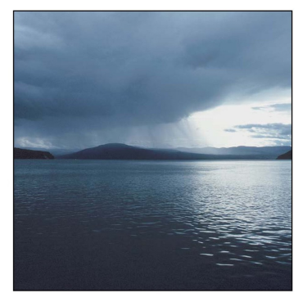
Spring Weather

Slide 2
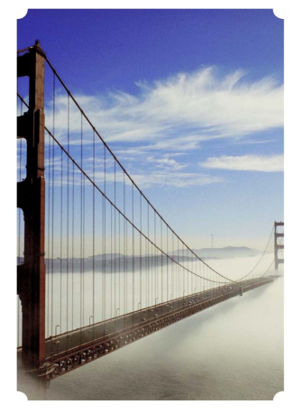
The fog comes.

Slide 3

The clouds come.

Slide 4
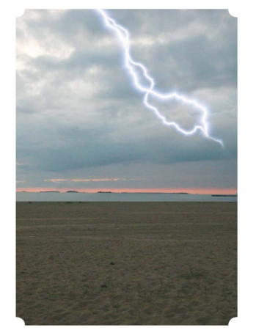
The storm comes.

Slide 5
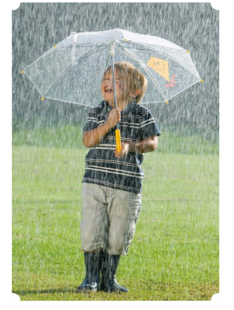
The rain comes.

Slide 6
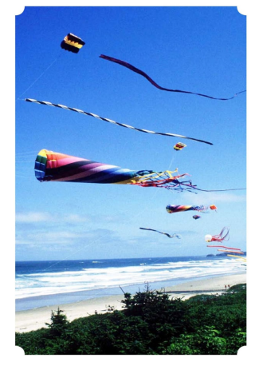
The wind comes.

Slide 7
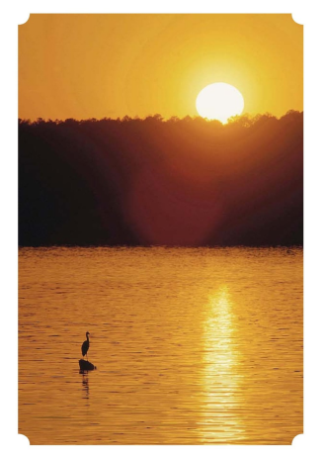
The sun comes.

Slide 8
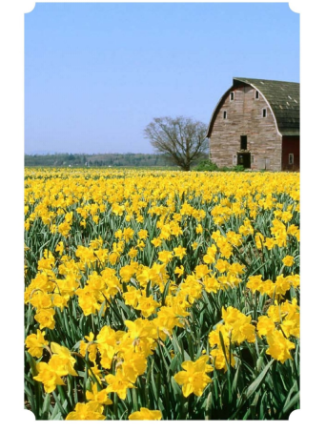
The flowers come.

Slide 9
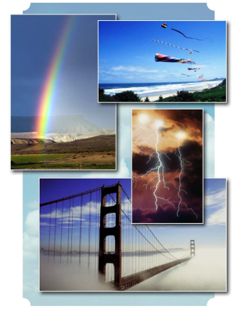
The spring comes.

Slide 10
Fog
Clouds
Storm
Click on the colored stars to start getting to know them!
Rain
Wind
Sun
Flowers
Spring

Slide 11
RETURN
The fog comes.

Slide 12
RETURN
The clouds come.

Slide 13
RETURN
The storm comes.

Slide 14
RETURN
The rain comes.

Slide 15
RETURN
The wind comes.

Slide 16
RETURN
The sun comes.

Slide 17
RETURN
The flowers come.

Slide 18
RETURN
The spring comes.

